Slide 1
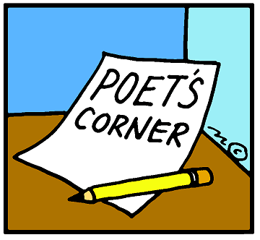
Poem of the Day
Little Red Riding Hood and the Wolf
By Roald Dahl

Slide 2
As soon as Wolf began to feel That he would like a decent meal, He went and knocked on Grandma's door. When Grandma opened it, she saw The sharp white teeth, the horrid grin, And Wolfie said, "May I come in?"

Slide 3
Poor Grandmamma was terrified, "He's going to eat me up!" she cried. And she was absolutely right. He ate her up in one big bite.
But Grandmamma was small and tough, And Wolfie wailed, "That's not enough! I haven't yet begun to feel That I have had a decent meal!" He ran around the kitchen yelping, "I've got to have a second helping!"

Slide 4
Then added with a frightful leer, "I'm therefore going to wait right here Till Little Miss Red Riding Hood Comes home from walking in the wood." He quickly put on Grandma's clothes, (Of course he hadn't eaten those). He dressed himself in coat and hat. He put on shoes, and after that, He even brushed and curled his hair, Then sat himself in Grandma's chair.

Slide 5
In came the little girl in red. She stopped. She stared. And then she said, "What great big ears you have, Grandma." "All the better to hear you with," the Wolf replied. "What great big eyes you have, Grandma." said Little Red Riding Hood.

Slide 6
All the better to see you with," the Wolf replied. He sat there watching her and smiled. He thought, I'm going to eat this child. Compared with her old Grandmamma, She's going to taste like caviar.

Slide 7
Then Little Red Riding Hood said, " But Grandma, what a lovely great big furry coat you have on." "That's wrong!" cried Wolf. "Have you forgot To tell me what BIG TEETH I've got? Ah well, no matter what you say, I'm going to eat you anyway."

Slide 8
The small girl smiles. One eyelid flickers. She whips a pistol from her knickers. She aims it at the creature's head, And bang bang bang, she shoots him dead. A few weeks later, in the wood, I came across Miss Riding Hood. But what a change! No cloak of red, No silly hood upon her head. She said, "Hello, and do please note My lovely furry wolfskin coat."

